Slide 1



MetaPred: Meta-Learning for Clinical Risk Prediction with Limited Patient Electronic Health Records
Xi S. Zhang, Fengyi Tang, Hiroko H. Dodge,
Jiayu Zhou, Fei Wang

Slide 2
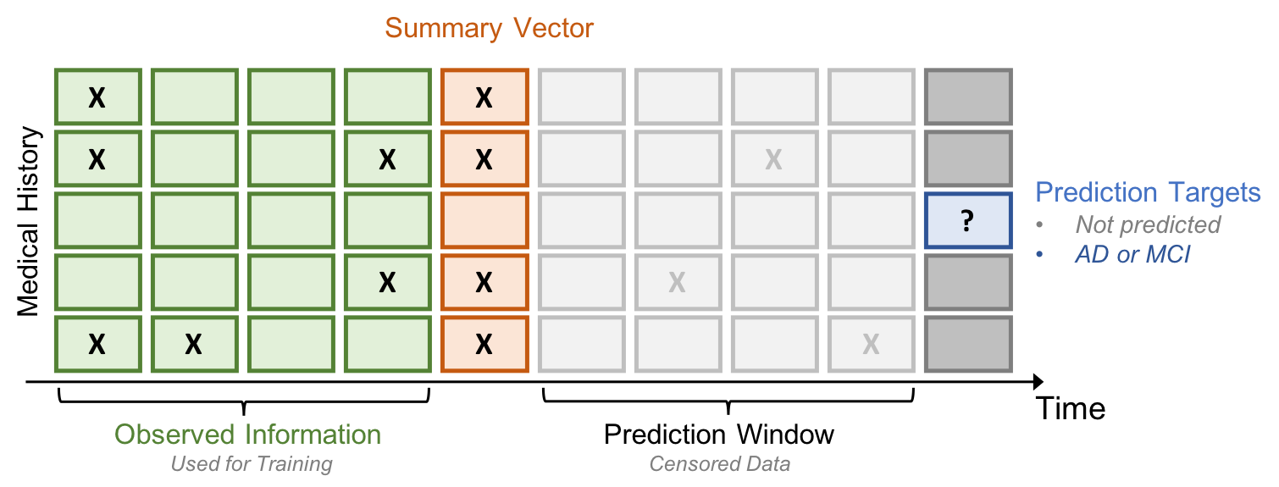
Clinical Risk Prediction
Patient EHRs: each patient has a sequence of vectors;
Predictive models: build for clinical risks, such as in-hospital mortality, hospital readmission, chronic disease onset, condition exacerbation, etc.
LR, SVM, k-Nearest Neighbor, Random Forest, MLP;
RNN, CNN.

Slide 3
Limited Patient EHRs
How about patient samples that are insufficient?
it is expensive and sometimes even impossible for obtaining labeled new samples
reusing data on other domain/tasks becomes a feasible strategy
- transfer learning
- meta-learning (learning to transfer)
Using the learning experiences from a set of relevant tasks …

Slide 4
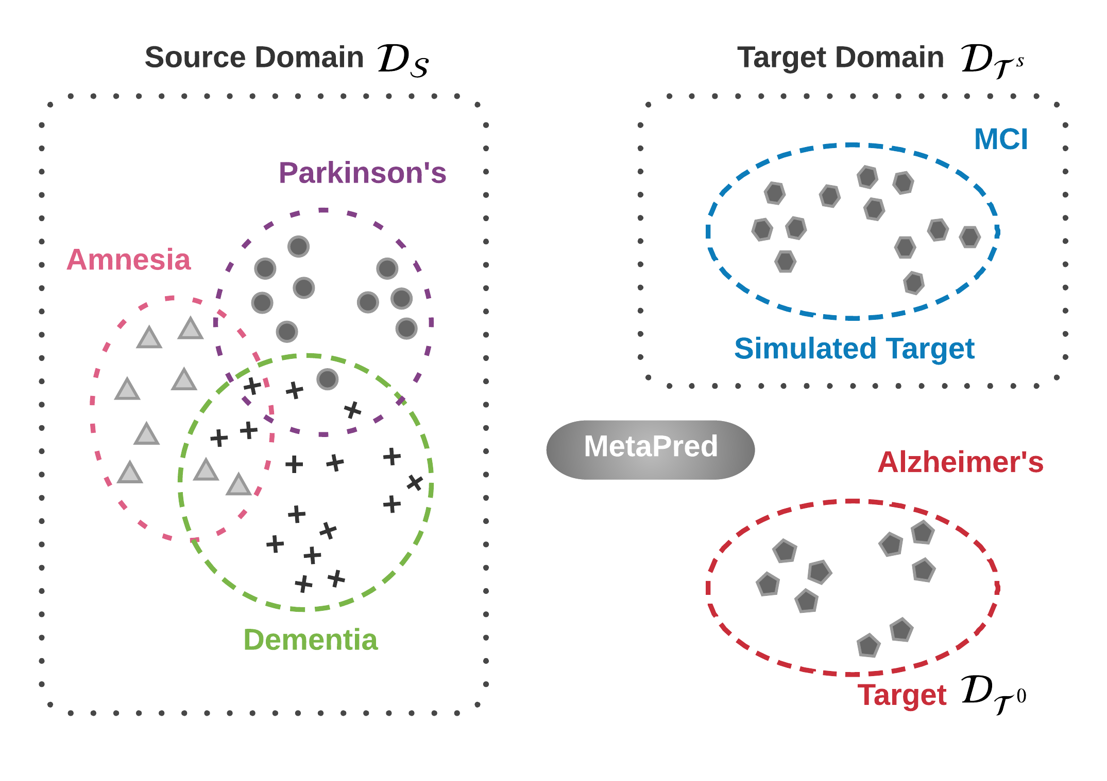
Problem Setup
Goal: is to predict the risks of target disease with few labeled patients, which give rise to a low-resource classification.
The idea: is to take advantage of labeled patients from other relevant high-resource domains and design the learning to transfer framework with sources and a simulated target.
Notes:
To do so, we divide the original source domains into sources and the simulated target.

Slide 5
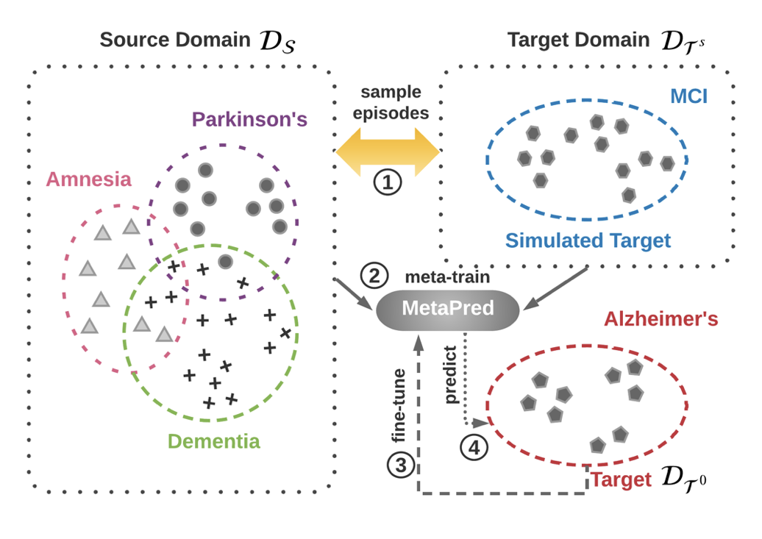
Problem Setup
4 steps:
sample episode
meta-train
fine-tune
predict
sample
sample episode
episodes
meta-train
fine-tune
meta-train
predict
predict
fine-tune

Slide 6
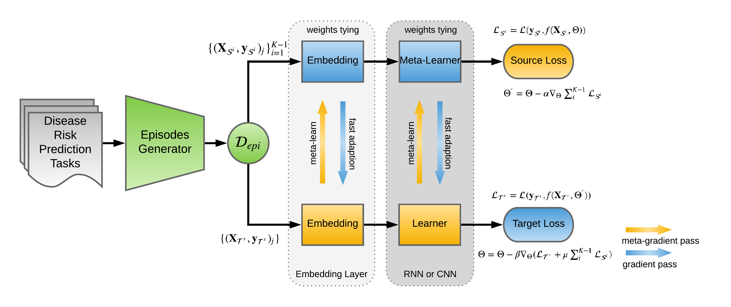
The MetaPred Framework
Optimization-Level Adaptation
Inner Loop
Outer Loop
Objective-Level Adaptation
Notes:
The predictive model could be RNN or CNN.
Parameters are tying so that a model-agnostic meta-learning strategy can be used to provide us a parameter initialization by the objective function in the source domain. Therefore, we have an inner iteration as well as an outer iteration, with fast adaptation for the feedforward pass and the meta-gradient updating for the backpropagation. We call this procedure as adaptation via optimization.
Also, we propose to improve the objective by incorporating supervision from source domains. That is because we do not hope the distributions between source and target domains are too diverse. In real-world healthcare scenario, however, patients who suffering difference diseases might have medical records at various visits with heterogeneity. it is difficult to obtain promising results by optimizing target risk itself. We call this as adaptation via objective.

Slide 7

Dataset
Notes:
experimental results on a real-world EHR dataset are reported. The data we used is the research data warehouse from Oregon Health & Science University Hospital.
For each domain, controls are patients suffering other cognitive disorders, which makes the tasks difficult and meaningful in practice.
We set mild cognitive impairment, Alzheimer’s Disease, and Parkinson’s Disease as Target Domain

Slide 8
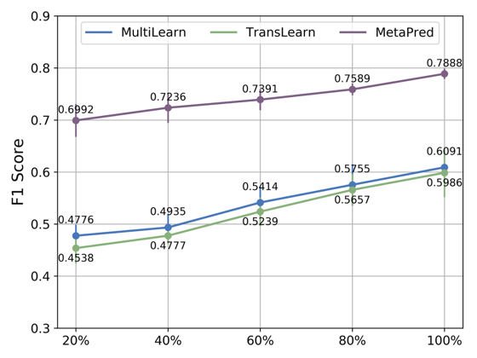
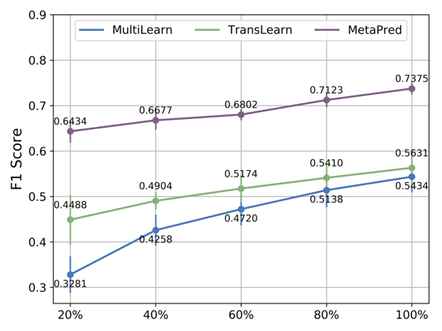
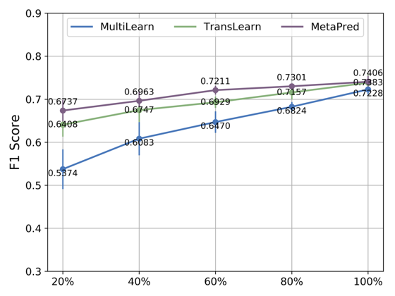
Results
Compared with multi-task learning and transfer learning.
Notes:
Here we give results with respect to different amounts of supervised data points used in fine-tuning for target domains. As we can see, our model outperforms the compared methods on all of the tasks.

Slide 9
Conclusion
Leverages deep predictive modeling with the model agnostic meta-learning to exploit the medical records from high-resource domain.
Introduce an objective- level adaptation for MetaPred which not only take advantage of fast adaptation from optimization-level but also take the supervision of the high-resources domain into account.
Extensive evaluation involving 5 cognitive diseases is conducted on real-world EHR data for risk prediction tasks under various source/target combinations.
Open Source Code:
https://github.com/sheryl-ai/MetaPred
Notes:
In summary, our method
uses deep predictive modeling with meta-learning for boosting performance of disease risk prediction.
For the purpose of designing a more transferable learning procedure, we introduce a novel meta-learning algorithm.
Extensive evaluation is conducted on real-world EHR data under various source/target combinations.
Open source code can be found on Github

Slide 10





Xi S. Zhang
Fengyi Tang
Hiroko H. Dodge
Jiayu Zhou
Fei Wang
MetaPred: Meta-Learning for Clinical Risk Prediction with Limited Patient Electronic Health Records

